Slide 1




A New Method to Organize, Identify, and Compare Water Management Data for Systems Models
Adel M. Abdallah and David E. Rosenberg
EWRI 2017
Notes:
This project is funded by National Science Foundation

Slide 2
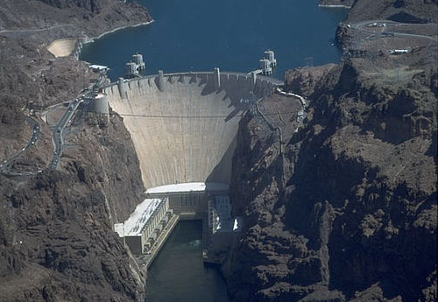




Challenges to work with systems data
Hoover Dam
Lake Mead
e.g., release
e.g., outflow
Dam, Reservoir, Water body, Site, Hydropower plant?

Slide 3
Design one data system to help overcome the challenges and streamline access to data
Notes:
This is how we access, manipulate, and query different data sources. Specific methods for each source and study area
This is how WaMDaM will allow us to use one method to query and compare data for many sources
Objective: a design that allows us to do these systemic comparions

Slide 4
WaMDaM Information Model
Notes:
These are the fundamental data and metadata elements for systems water management models based on my review of existing systems
Solves the inconsistency in syntax (files and structure of data)
Introducing CVs reconciles the inconsistency in different terminologies as I show next
The information model design is independent of an technologic implementation.

Slide 5
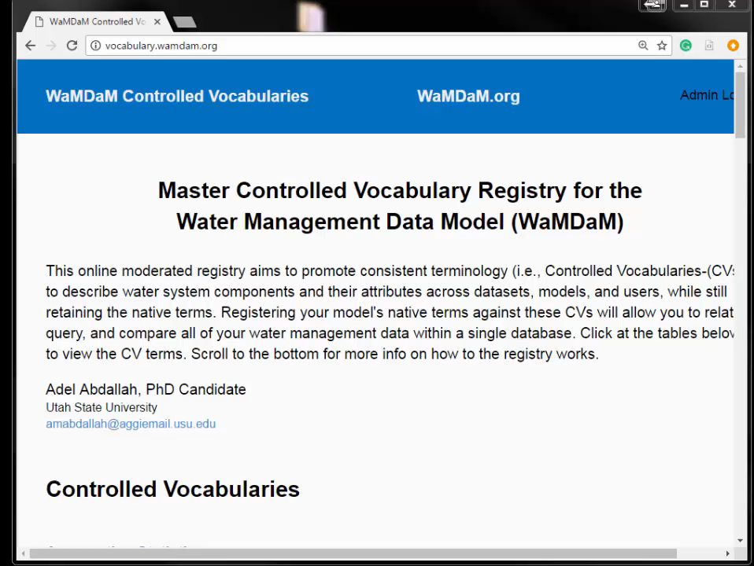
Online Moderated Vocabulary System
DataSource/Model | Native Attribute Name
Utah DWR Dams Dataset Utah Dams Dataset Utah Dams Dataset | Maximum Capacity
 | STORG_ACFT
 | STRG_SPILL
 | MaxCap
USGS National Dams Dataset | MAX_STOR | Volume
 | NORMAL_STO
USACE Dams Dataset | Max Storage
 | NID Storage
WASH 2017 | maxstor
WEAP 2017 | Storage Capacity
Notes:
Users can view all the CV terms and download them at http://vocabulary.wamdam.org/
They also can submit new terms and will receive confirmation emails
If the new term is accepted, it will be added to the list
How to use WaMDaM? Next slide

Slide 6
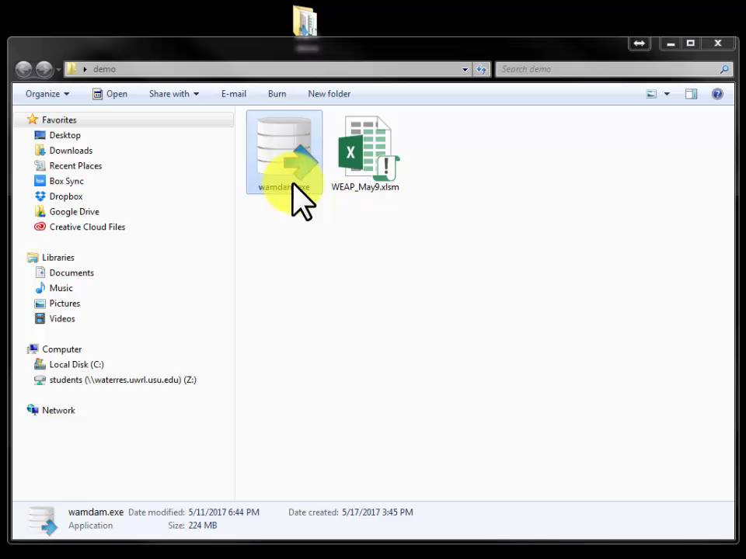
Load Data to WaMDaM
Notes:
Implemented in relational SQLite and cross-platform Python-based data loader
Import from Excel template
Import from CUAHSI Web-Services
Import from Western Council Water Exchange Web-Services
Query and Compare without coding

Slide 7
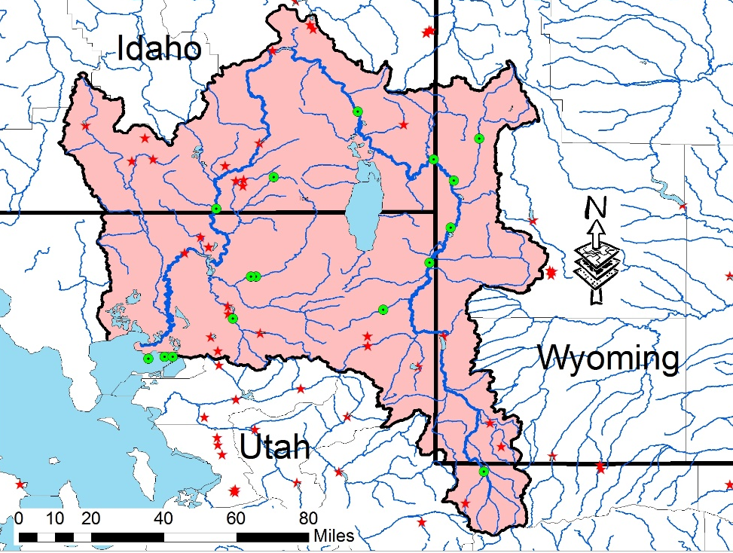
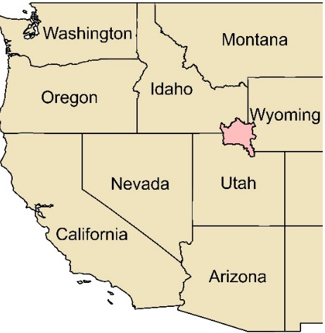
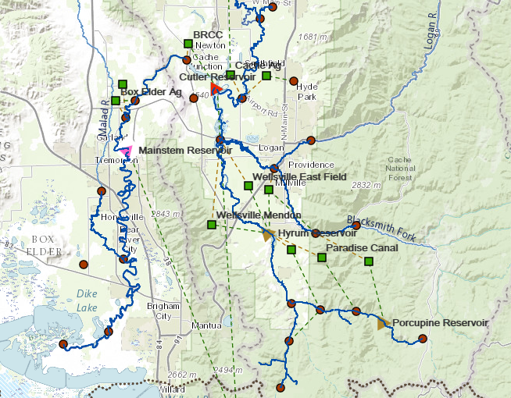
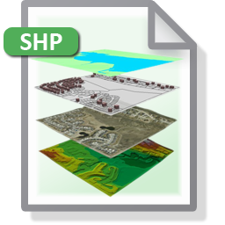

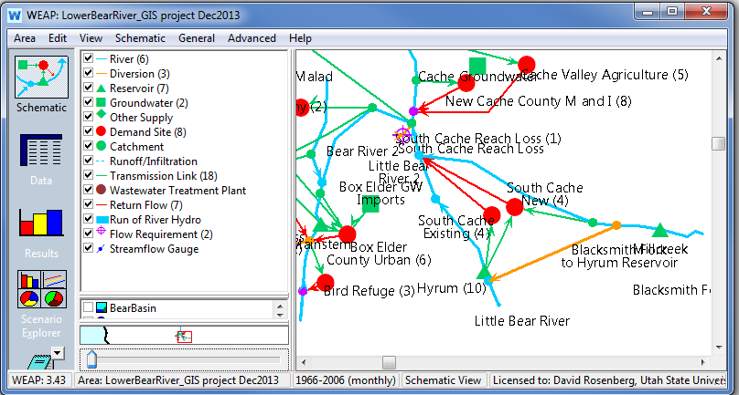
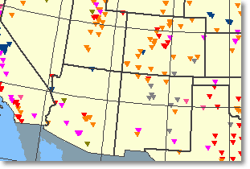

Application: Organize, query, and compare data in the Bear River Watershed, Utah
WASH
WEAP
Utah & Idaho Diversions
Notes:
I used all these different datasets and models to verify and demonstrate WaM-DaM design to work with multiple datasets
Load and integrate data for the Bear River Watershed which spans Utah, Wyoming, and Idaho
I focus on the Lower Bear River in Utah. Next I will answer the questions I asked earlier

Slide 8
What water system components are in a study area?
Notes:
First, what are the system components in my study area (within a geo-spatial boundary). The source is a WEAP model /Scenario 1
Second, it shows the components from a second scenario (changes in how the demand sites are represented)
Third, shows the same systems components exist in a different model (WASH) but under different names.
We retrieve all of the components because they are all related though controlled vocabulary (River, Stream, s) (Transmission Link, Diversion, DiversionExisit)
If we want to build a third model, we choose the systems components from these retrieve instances.
The ability to search for nodes and links from many sources is a major improvement over searching only for time series sites in CUAHSI

Slide 9
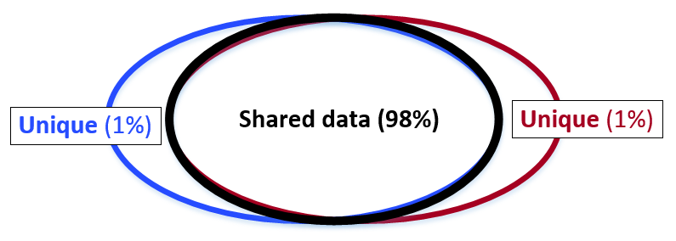
What are the difference in data values between two scenarios?
Notes:
It also tells you what is different in data values

Slide 10
What is the storage volume of Hyrum Reservoir, Utah?
Maximum Capacity
MAX_STOR
MaxCap
maxstor
Notes:
Because of using controlled vocabulary, we are able to retrieve two Elevation-Storage curves for Hyrum Reservoir
Zoom in. There is a difference between then not only in the extent, but in their values. The same elevation could have storage of 10,000 AF or over 13,000 feet.
See the different maximum storage values I found with their different terms from multiple sources
we could see the source and the people who reported these values and contact them for further info if needed
We could include these differences in sensitivity analysis

Slide 11
What is the total agriculture demand in Cache County, Utah?
Notes:
Here is a comparison in total annual agriculture surface water demand (diversion) between the WASH Model and the WaDE web-services.
The WaDE web-service only (for now) provides total annual diversions for the entire Cache County. The WASH Model has many agg demand sites which I summed together. After discussions with Ayman, the differences are probably related to some aggregations and assumptions for the demand sites in WASH (what is included and what is not included in Cache County between WASH and WaDE).
Take home message, comparisons will make us rethink about the assumptions in aggregated data (what they include and what they do not include)

Slide 12
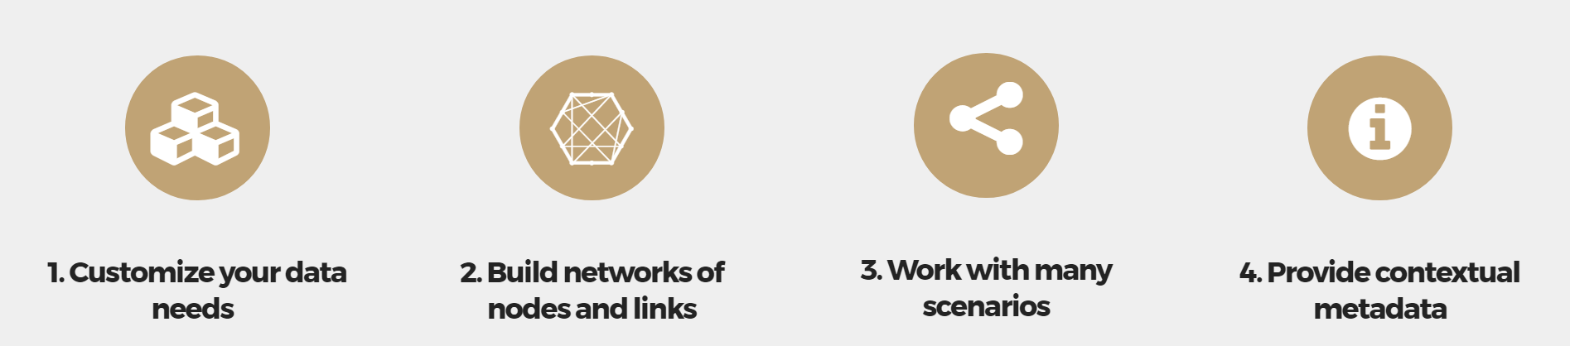
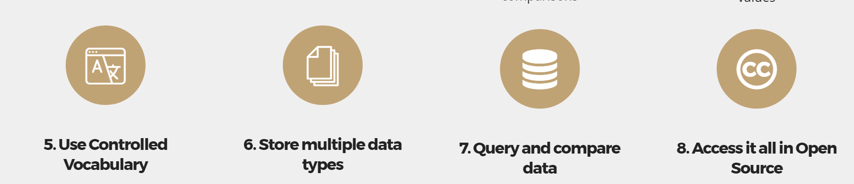
WaMDaM provides features to manage data for systems models
HydraPlatform, CUAHSI (ODM), WaDE, HEC-DSS
Notes:
Talk about this slide as: - Today, I've showed features #2, 3, 4, 5, 6, and 7.
- WaMDaM also works with custom data sets (#1) and can be accessed in an open source environment (#8).
- Together, these features allow the user to ...

Slide 13
Further Work: Compare modeling methods in a common study area
Notes:
Emphasize reuse existing methods to send the same data to multiple models.
This allows comparisons across models and across study areas.

Slide 14
Conclusion
Controlled vocabulary allow to query and compare across data sets
Comparisons reveal similarities and discrepancies
Build tools to speed data loading and validate data loaded
Requires time + effort to load data
Further participation by others will expand usefulness of data system
Notes:
We do our best to build algorithms that best represent out systems. Getting the differences in input data right could be as important to have the buy in from stakeholders
It required up to 19 emails and two personal visits, using SQL Server to join shapefile and two excel workbooks of Utah Reservoirs.
The National Dams dataset indicated Hydropower as a purpose in only 8 Utah dams but another local dataset showed 49 hydropower dams
Tricky controlled vocabulary:
to storage in elevation or volume
Datasets refer to capacity in flow or volume

Slide 15

Thank you Questions?
For more info: Adel Abdallah
amabdallah@aggiemail.usu.edu
http://rosenberg.usu.edu/
WaMDaM.org
WaMDaM
The Water Management Data Model Organize. Compare. Prepare Data to Models.
This material is based upon work supported by the National Science Foundation (NSF) under Grants 1135482 (CI-Water) and 1208732 (iUtah). Any opinions, findings, and conclusions or recommendations expressed in this material are those of the author(s) and do not necessarily reflect the views of the NSF.

